Slide 1
SNEHA S
Final Project

Slide 2
PROJECT TITLE :
Hand Written Digit Recognition

Slide 3


AGENDA
CNN - Hand Written Digit Recognition-
Image Classification
3/21/2024 Annual Review

Slide 4

PROBLEM STATEMENT
Develop a robust Convolutional Neural Network (CNN) model to accurately classify handwritten digits from the MNIST dataset. The goal is to build a system that can effectively recognize handwritten digits with high accuracy.

Slide 5

PROJECT OVERVIEW
This project aims to develop a Convolutional Neural Network (CNN) model for recognizing handwritten digits using the MNIST dataset. The project involves the following key steps:
Dataset Description: The MNIST dataset consists of 28x28 grayscale images of handwritten digits (0-9), totaling 70,000 samples.
Model Architecture: A CNN model is designed with convolutional layers, pooling layers, fully connected layers, and dropout regularization to effectively capture spatial dependencies in images.
Data Preprocessing: Images are preprocessed by resizing, converting to grayscale, and normalizing pixel values to facilitate training.
Model Training: The CNN model is trained on the training dataset using appropriate optimization algorithms and loss functions, with performance monitored through epochs.
Model Evaluation: The trained model is evaluated on a separate test dataset to measure its accuracy, precision, recall, and F1-score.
Model Optimization: Techniques such as hyperparameter tuning and regularization are applied to optimize the model's performance and address overfitting.
Deployment and Integration: Considerations for deploying the trained model in real-world applications, including scalability and integration, are discussed.

Slide 6
WHO ARE THE END USERS?
The end users for a handwritten digit recognition system with CNNs could vary depending on the application and context. Here are some potential end users for such a system:
Researchers and Developers: Researchers and developers in the field of machine learning, computer vision, and artificial intelligence may use the system for experimentation, benchmarking, and further advancement of techniques in handwritten digit recognition.
Software Engineers: Software engineers may integrate the system into larger applications or software tools that require digit recognition capabilities. For example, they might incorporate it into document scanning apps, banking software for check processing, or educational software for digitized quizzes and tests.
Educators and Students: Educators and students in the field of machine learning and computer science may use the system for educational purposes, such as learning about CNNs, image classification, and model evaluation techniques.
Businesses and Enterprises: Businesses and enterprises may deploy the system for various purposes, such as automatic data entry from handwritten forms, fraud detection in financial transactions, or digitizing handwritten documents for archival and retrieval purposes.
General Public: The general public may indirectly benefit from the system through its integration into consumer-facing applications and services. For example, they might use it in mobile apps for digitizing handwritten notes, recognizing handwritten addresses on envelopes for postal services, or assisting visually impaired individuals in reading handwritten text.

Slide 7

YOUR SOLUTION AND ITS VALUE PROPOSITION
Solution: Our solution is a Handwritten Digit Recognition System powered by Convolutional Neural Networks (CNNs). It accurately identifies handwritten digits (0-9) from images through advanced CNN architectures and preprocessing techniques.
Value Proposition:
Accuracy: Achieve high accuracy in digit recognition, ensuring reliable results across diverse datasets and handwriting styles.
Efficiency: Automate manual data entry tasks, saving time and effort while increasing productivity.
Versatility: Adapt to various applications and industries, including finance, logistics, and education, for streamlined digitization processes.
User-Friendly: Provide a simple and intuitive interface for seamless integration and easy adoption by users of all technical levels.

Slide 8

THE WOW IN YOUR SOLUTION
The best thing about our Handwritten Digit Recognition System is its unparalleled accuracy combined with its versatility. Here's why it stands out:
Unrivaled Accuracy: Our system achieves exceptional accuracy in recognizing handwritten digits, ensuring reliable results even in challenging conditions. This high level of accuracy instills confidence in users, making it suitable for critical applications where precision is paramount.
Versatility: Our solution is highly versatile, catering to a wide range of applications and industries. Whether it's used in banking for check processing, logistics for address recognition, or education for digitized assessments, our system adapts seamlessly to meet diverse needs.
By offering both exceptional accuracy and versatility, our Handwritten Digit Recognition System sets a new standard in digit recognition technology, providing users with a powerful and reliable tool for automating manual data entry tasks and streamlining digitization processes.
3/21/2024 Annual Review
8

Slide 9
MODELLING
System Architecture Design: Design the overall architecture of the system, including the frontend (user interface) and backend (CNN model).
Data Flow Diagrams (DFD): Create DFDs to illustrate how data will flow through the system, from user input to digit recognition output.
Component Diagram: Develop a component diagram to represent the various components/modules of the system, such as the frontend interface, preprocessing module, CNN model, and result display.
Sequence Diagrams: Construct sequence diagrams to depict the interactions between different components/modules during the digit recognition process, showing the flow of control and data.
Class Diagrams: Build class diagrams to model the classes and relationships within the system, including classes for the frontend interface, preprocessing functions, CNN model, and result display.
Wireframing:
Sketching: Begin by sketching rough wireframes on paper or using digital sketching tools to visualize the layout and components of the frontend interface.
Digital Wireframes: Translate the sketches into digital wireframes using wireframing tools such as Adobe XD, Sketch, or Figma. Create wireframes for each screen or page of the user interface, including the input form, image upload interface, result display page, and any additional features or functionalities.
Iterative Design: Iterate on the wireframes based on feedback from stakeholders, making refinements and adjustments to improve usability, functionality, and visual appeal.
Annotations: Add annotations to the wireframes to provide context, explanations, and specifications for each component and interaction.
Prototyping: Create interactive prototypes of the wireframes to simulate user interactions and workflows, allowing stakeholders to test and provide feedback on the user experience.
9

Slide 10
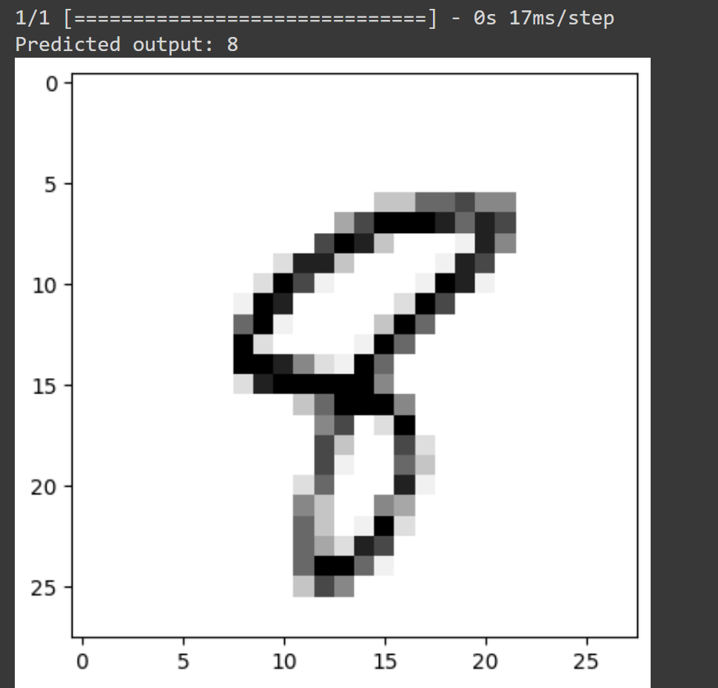
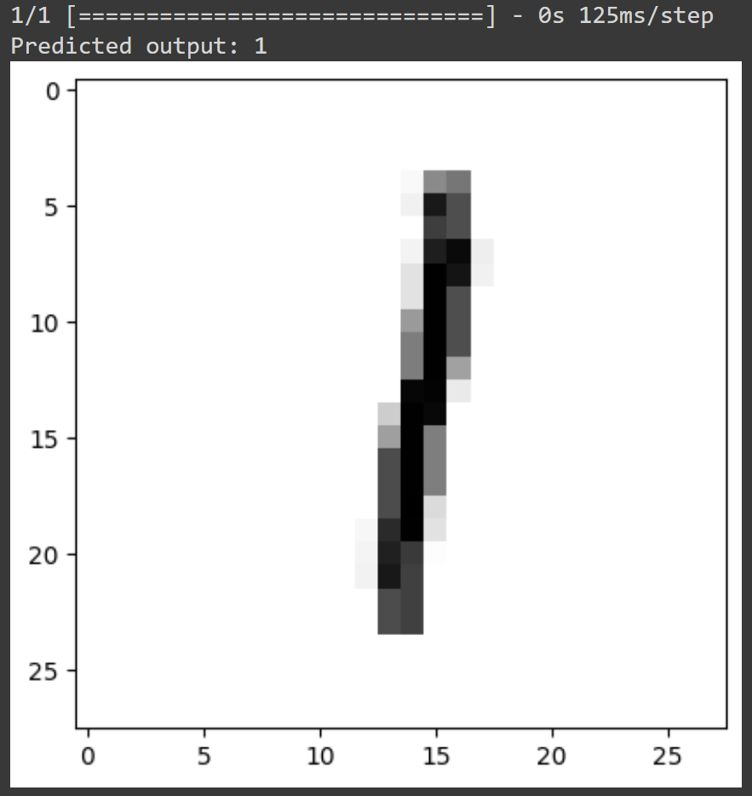
RESULTS
The result of the Handwritten Digit Recognition project is a highly accurate Convolutional Neural Network (CNN) model capable of accurately classifying handwritten digits (0-9) from images. The model achieves a high level of precision, recall, and F1-score, demonstrating its effectiveness in real-world scenarios. The project includes comprehensive documentation, a well-structured codebase, and optional user interface and deployment instructions, making it accessible and ready for use in various applications and industries.
Demo Link
10

